Slide 1


Electromagnetic simulation of the optical response of gold triangular nanoprism: The eﬀect of dielectric substrate
Shoukath Ali : 6819945
Hala Fares : 6772271
Supervisor : Dr. Viktor Myroshnychenko
Theoretische Elektrotechnik Group
Paderborn University
Masters project – Final Talk

Slide 2
Index
Objective
Nanoparticles
Theory
Self-supporting Au nanoprism
Au nanoprism on substrate
Summary
Future work
Notes:
This is how presentation is structured

Slide 3
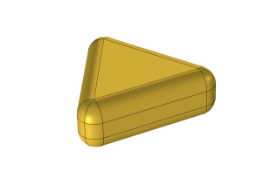
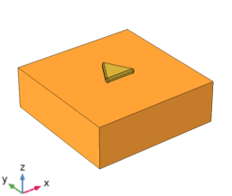
Objective
Plane wave 1
Optical cross-section
Compare
Plane wave 1
Optical cross-section
Plane wave 2
z
E
y
Plane wave 1
k
x
z
E
y
k
x
Plane wave 2
Notes:
Study the optical cross section spectrum(such as ……) of a self supporting triangular gold NP illuminated by a plan wave incident in the neg.z direc and polarised along x axis
And tring gold NP on a semi finite subs illuminated by two plane waves one along x and one aong y with neg z direction propagation. Compare the result and see the effect of the dielectric substrate

Slide 4
Nanoparticles
Types of nanoparticles:
Different Metal nanoparticles
What are nanoparticles?
Advantages:
Nanoparticles
Inert metal
Strong optical response in the visible region
Different resonat frequencies different colours
Inorganic(Metal)
Organic
Au
Ag
Al
Cu
Notes:
NPs r minute structure with larg surface area to volumn
.shape and siye of… influence its property
We r specifically interested in metal nano particles
In inorg we have metaj like ….. We r interested in gold

Slide 5
Application of nanoparticles
Soalr cells
Drugs and medication
electrons
manufacturing
Application of nanoparticles
Many more
Notes:
Electronics: creat big digital displays ,low cost, high efficiency…….

Slide 6
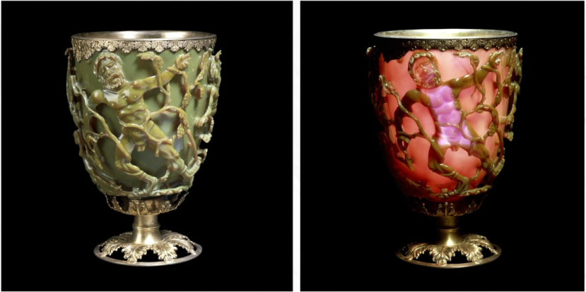
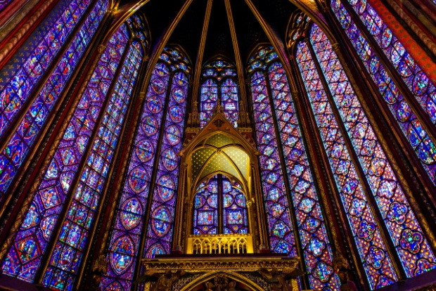
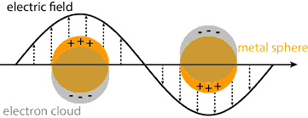
Optical properties of gold nanoparticles
Usage of gold nanoprticles in the last decades
[2]
[3]
Surface plasmon resonance:
LSPR : Localised Surface Plasmon Resonance
[4]
Phenomena of Localised Surface Plasmon(LSPR)
Notes:
Artist used optical properties to creat brilliant color by inserting ….. Groups of colors were generated
SPR : FREE CHARGES-oscillating charges=PLASMON-CONDITION ::::
SPP: em: EXCITATION that propogate in a wave form along a planar interface between diel and metal mediums whose electric field declines exponnialy with the space ( MAXWELL equations should be solved seperatly in 2 mediums to derive the electric fild)
LSPR: an OPTICAL EVENT created by light when it come on contact eith a conductive np , NP is lesser than the wave length, Efield can be used to move electrons from its stable position ending with oscillating with the same freq of metal
Light incident …some radiation will be absorbed some scattered in all direction by oscillating chrges

Slide 7
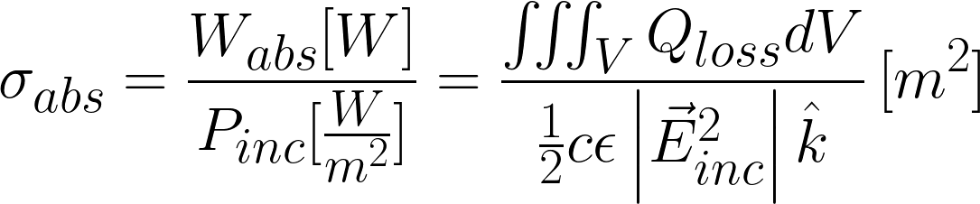
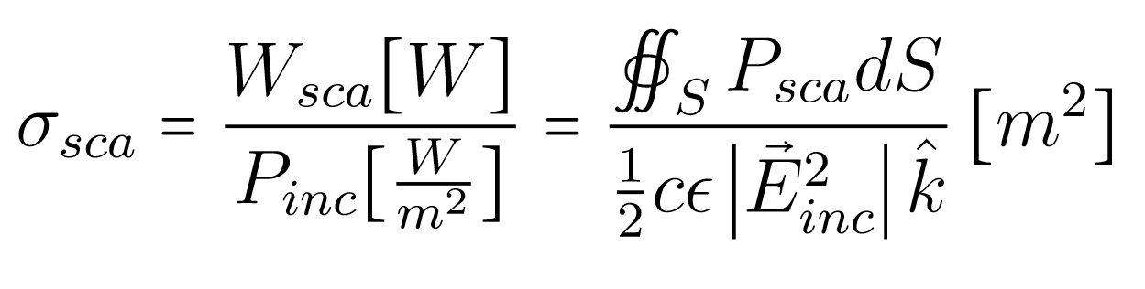
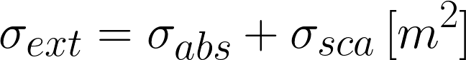
Optical cross-section parameters
Absorption cross-section
Scattering cross-section
Extinction cross-section
[1]
Notes:
Scattering cross section determines how much radiation is scattered by particle and can be calculated by the Mie theory formulations …….RATIO OF SCATTERED ENERGY TO INCIEBENT ENERGY FLUX
ABSORPTION CROSS SECTIN : is the ratio of the energy absorbed by particle to incidenet ENERGY FLUX
EXTINCTION CROSS : IS THE AMOUNT OF ENERGY THAT REMOVED FROM E FILED DUE TO ABSORP AND SCATTER
From scattered field many important physical quantity can be obtained such as cross section

Slide 8
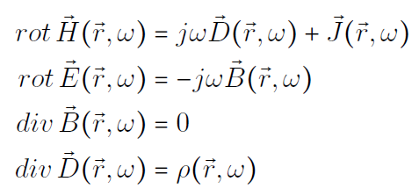
Maxwell Equations
Maxwell Equations:
Ampere-Maxwell:
Faraday:
Gauss for B-field:
Gauss for E-field:
Notes:
Used to describe the interaction of the electric feld with the metall

Slide 9
Simulation tool and Theory
COMSOL : COMSOL is a multiphysic simulation software
COMSOL offers different boundary conditions
Perfectly Matched Layer(PML)
Finite Element Method – for calculations
Notes:
In comsol these B C are applied to an exterior layer that surround the solution domain and used to absorb scattered radiation with out reflection
Deviding……. We apply the üptical cross section formulation to each element and then
comsol compines the enteire solutions

Slide 10
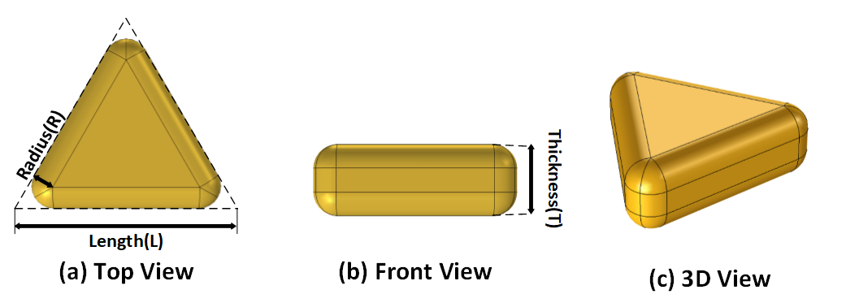
Au triangular nanoprism
Parameters | Values
Radius(R) | 10nm
Thickness(T) | 30nm
Length(L) | 50nm – 250nm

Slide 11
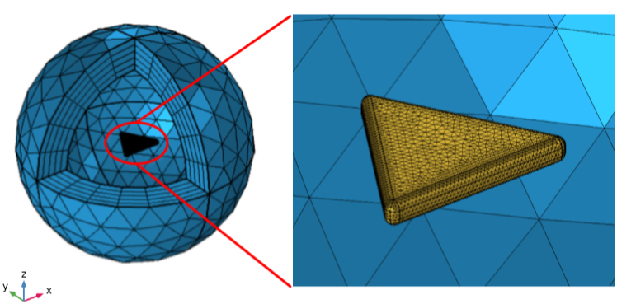
Self-supporting Au nanoprism
Fig: User meshed model of self-supporting Au nanoprism

Slide 12
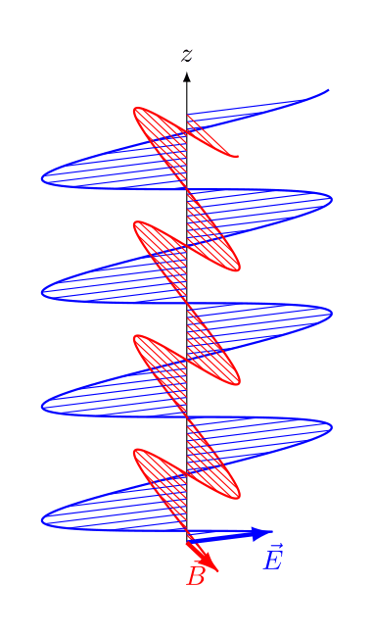
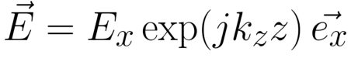

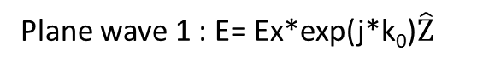
Visual representation of planes
Plane wave 1 : E= Ex*exp(j*k₀)$\hat{Z}$
z
E
y
k
x
y
E
x
k
-z

Slide 13
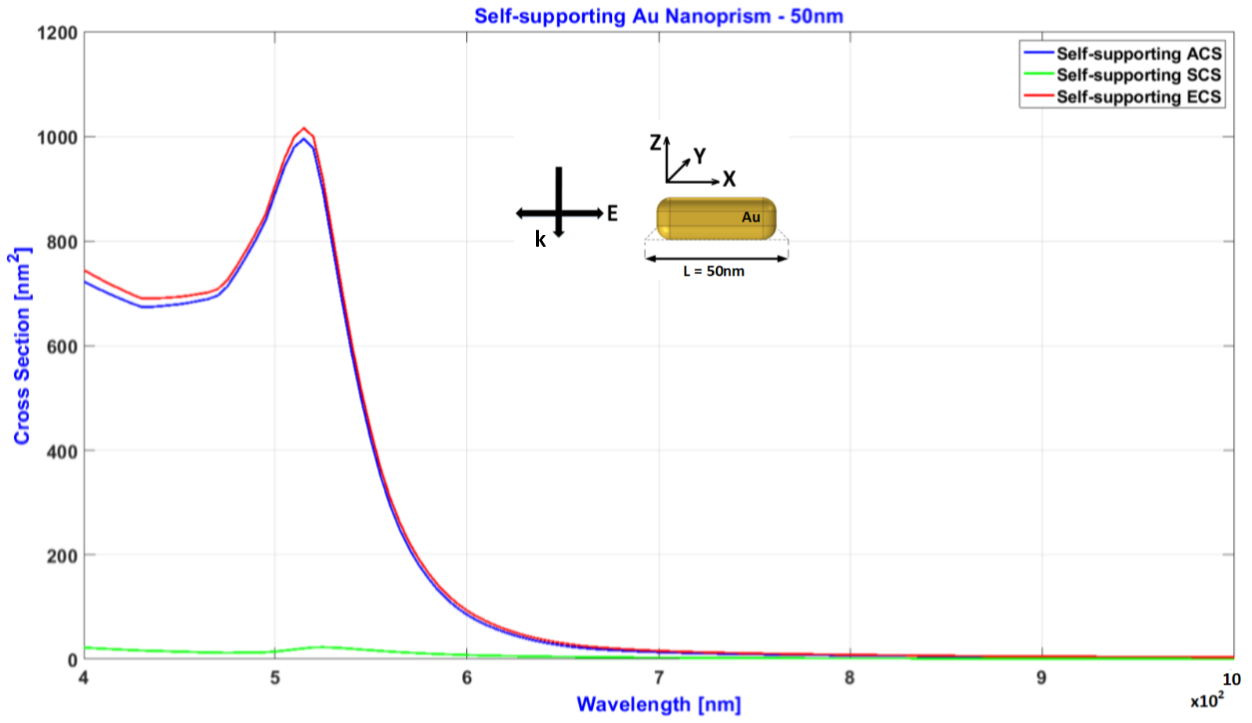
Self-supporting Au nanoprism, L = 50nm
515nm

Slide 14
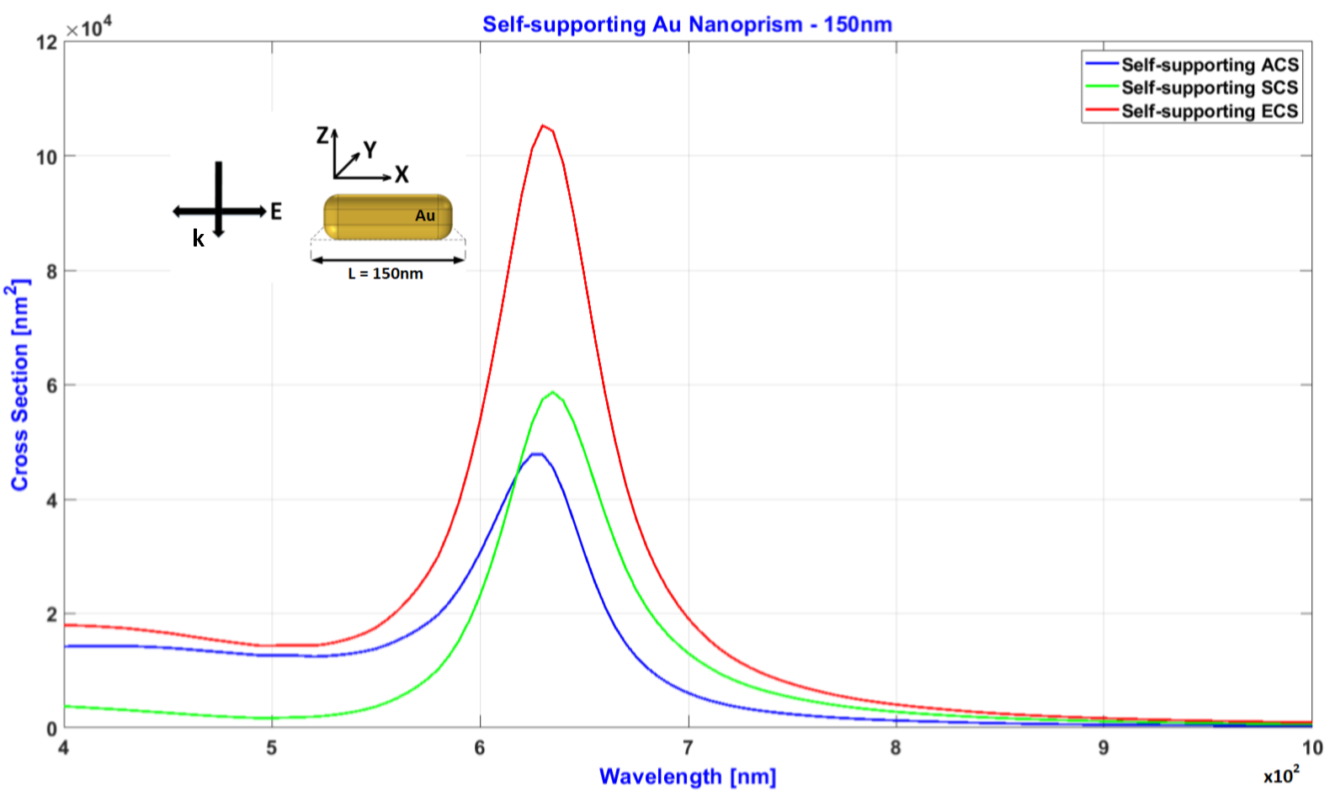
Self-supporting Au nanoprism, L = 150nm
630nm

Slide 15
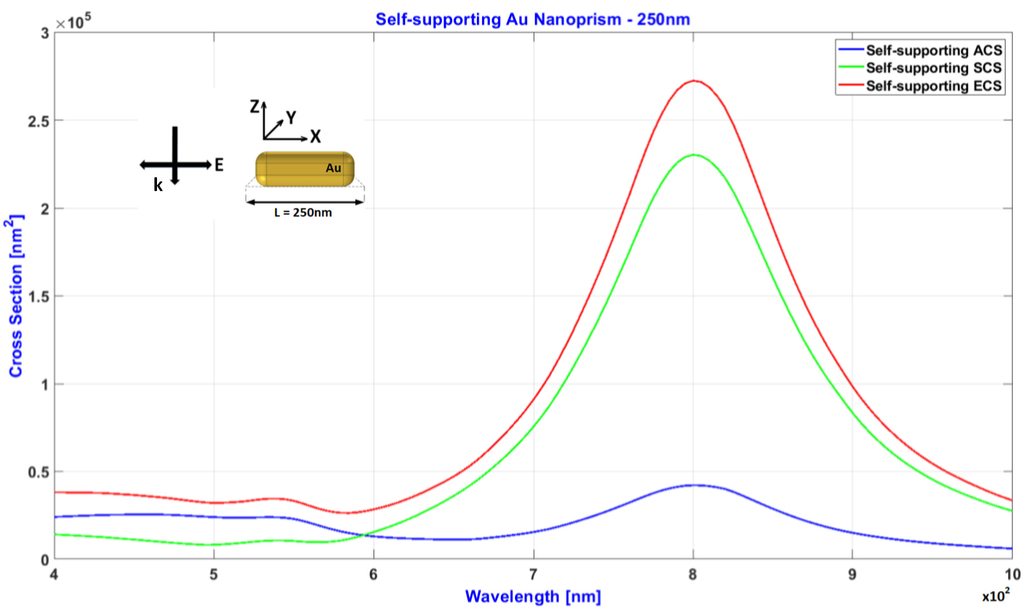
Self-supporting Au nanoprism, L = 250nm
800nm
545nm

Slide 16
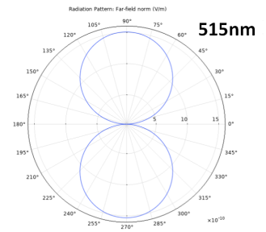
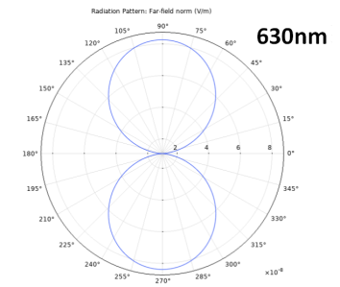
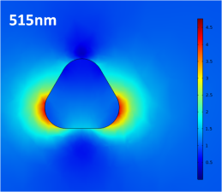
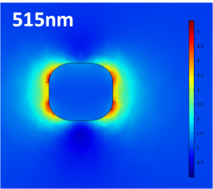
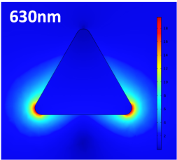
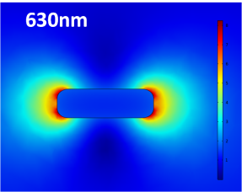
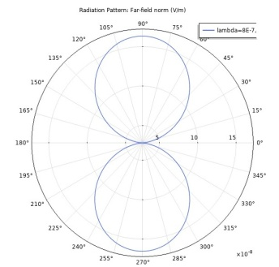
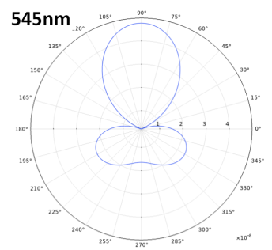
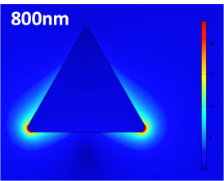
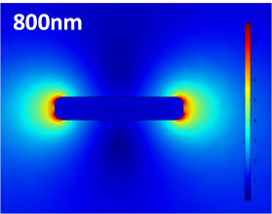
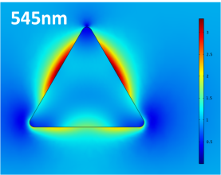
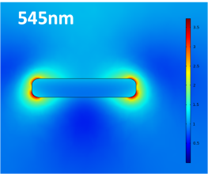
Near- and far-field plots
L = 50nm
L = 150nm
xy-plane
xz-plane
xy-plane
xz-plane
L = 250nm
L = 250nm
800nm
xy-plane
xz-plane
xy-plane
xz-plane
Dipolar resonance
Quadrapolar resonance

Slide 17
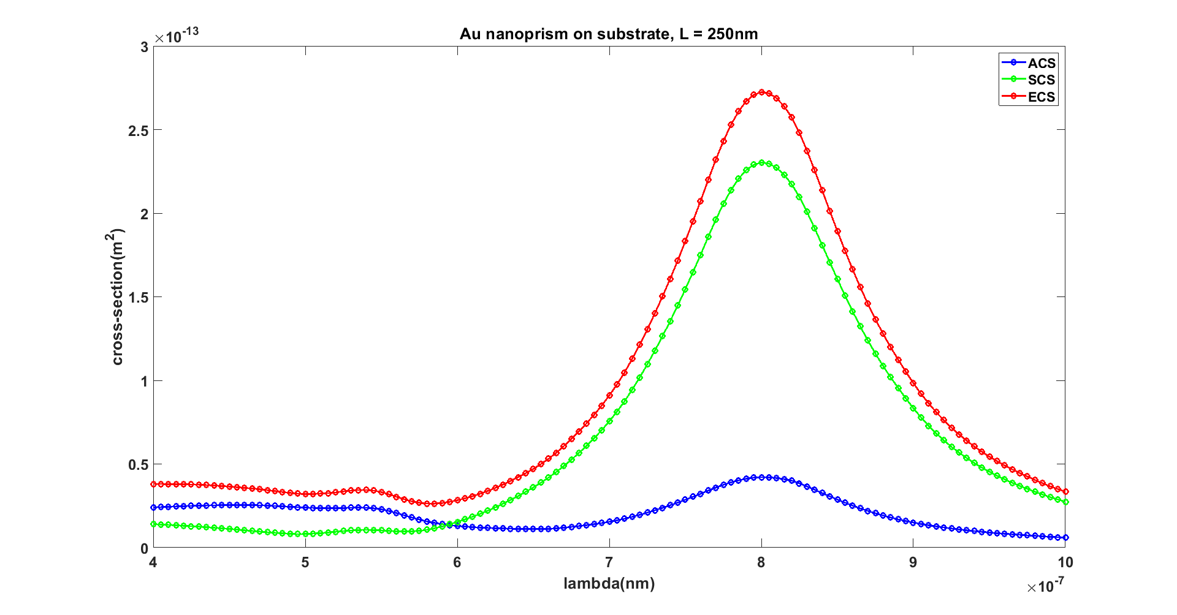
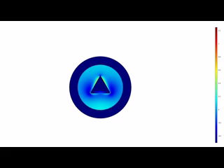
Visualizing near-field
z
E
y
k
x
Wavelength(nm)
10²

Slide 18
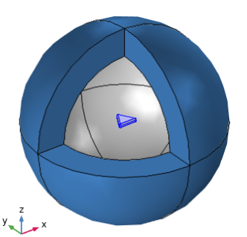
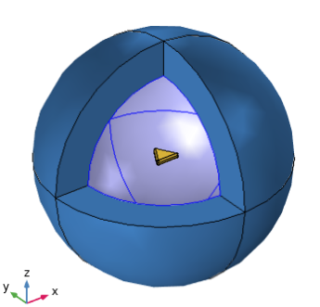
Methods to calculate SCS
Fig1: SCS calculation from the surface of the nanoprism
Fig1: SCS calculation from the surface of the internal PML

Slide 19
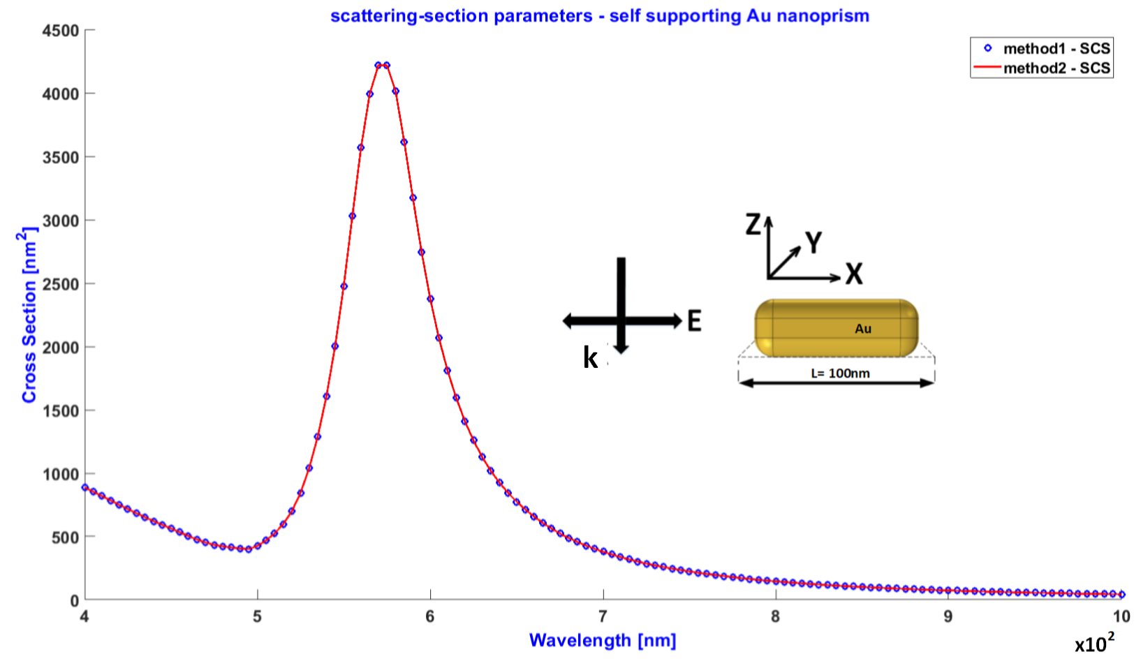
Methods to calculate SCS
565nm

Slide 20
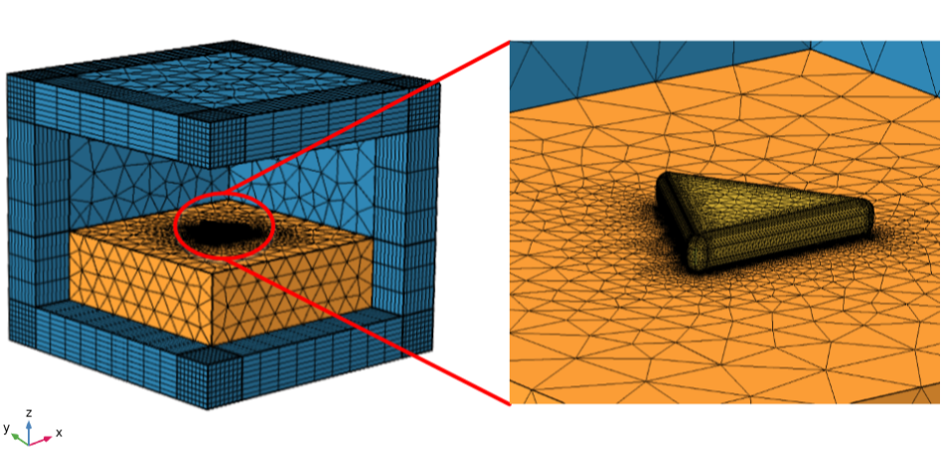
Au nanoprism on substrate
Fig: User meshed Au nanoprism on substrtate

Slide 21
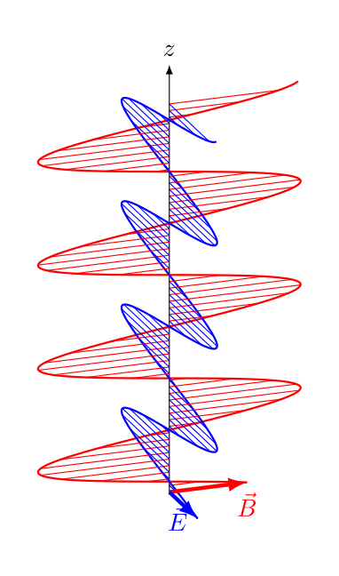
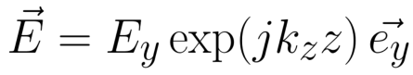
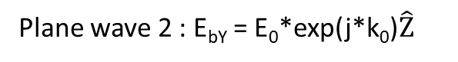
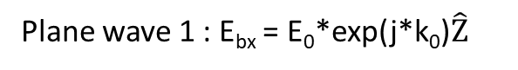
Visual representation of planes
E
y
E
x
y
x
k
k
-z
-z
Plane wave 1 : E_{bx} = E₀*exp(j*k₀)$\hat{Z}$
Plane wave 2 : E_{bY} = E₀*exp(j*k₀)$\hat{Z}$

Slide 22
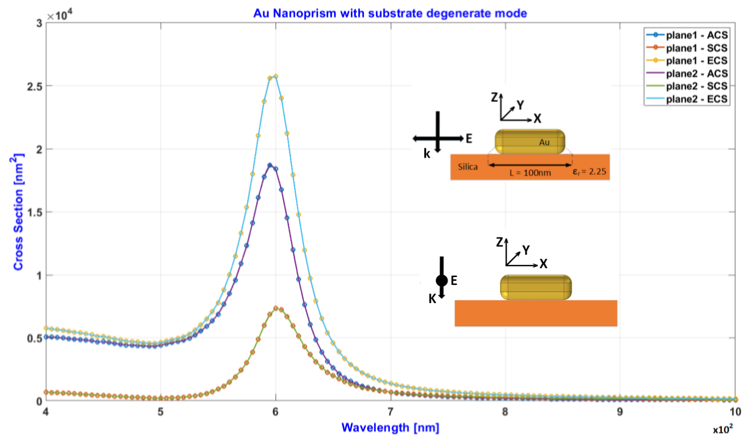
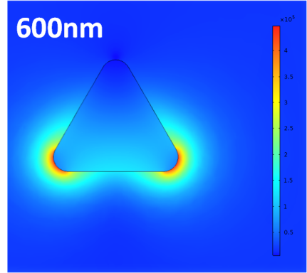
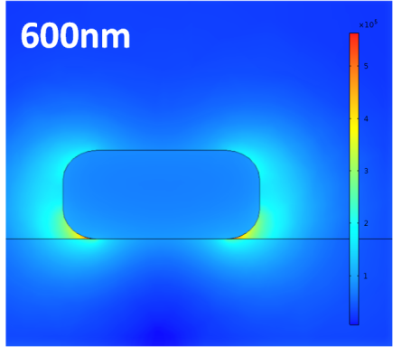
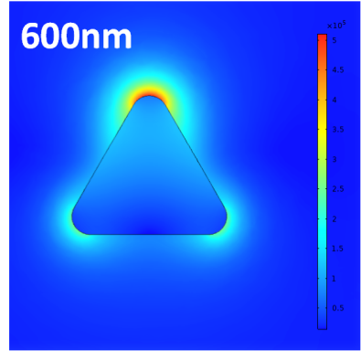
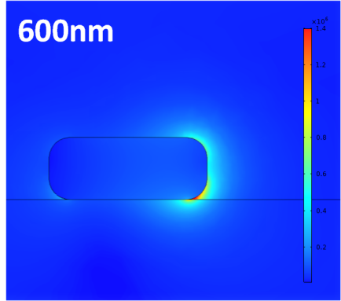
Degenerate mode
xy-plane
xz-plane
Near field plot plane wave 1
Near field plot plane wave 2
xy-plane
yz-plane

Slide 23
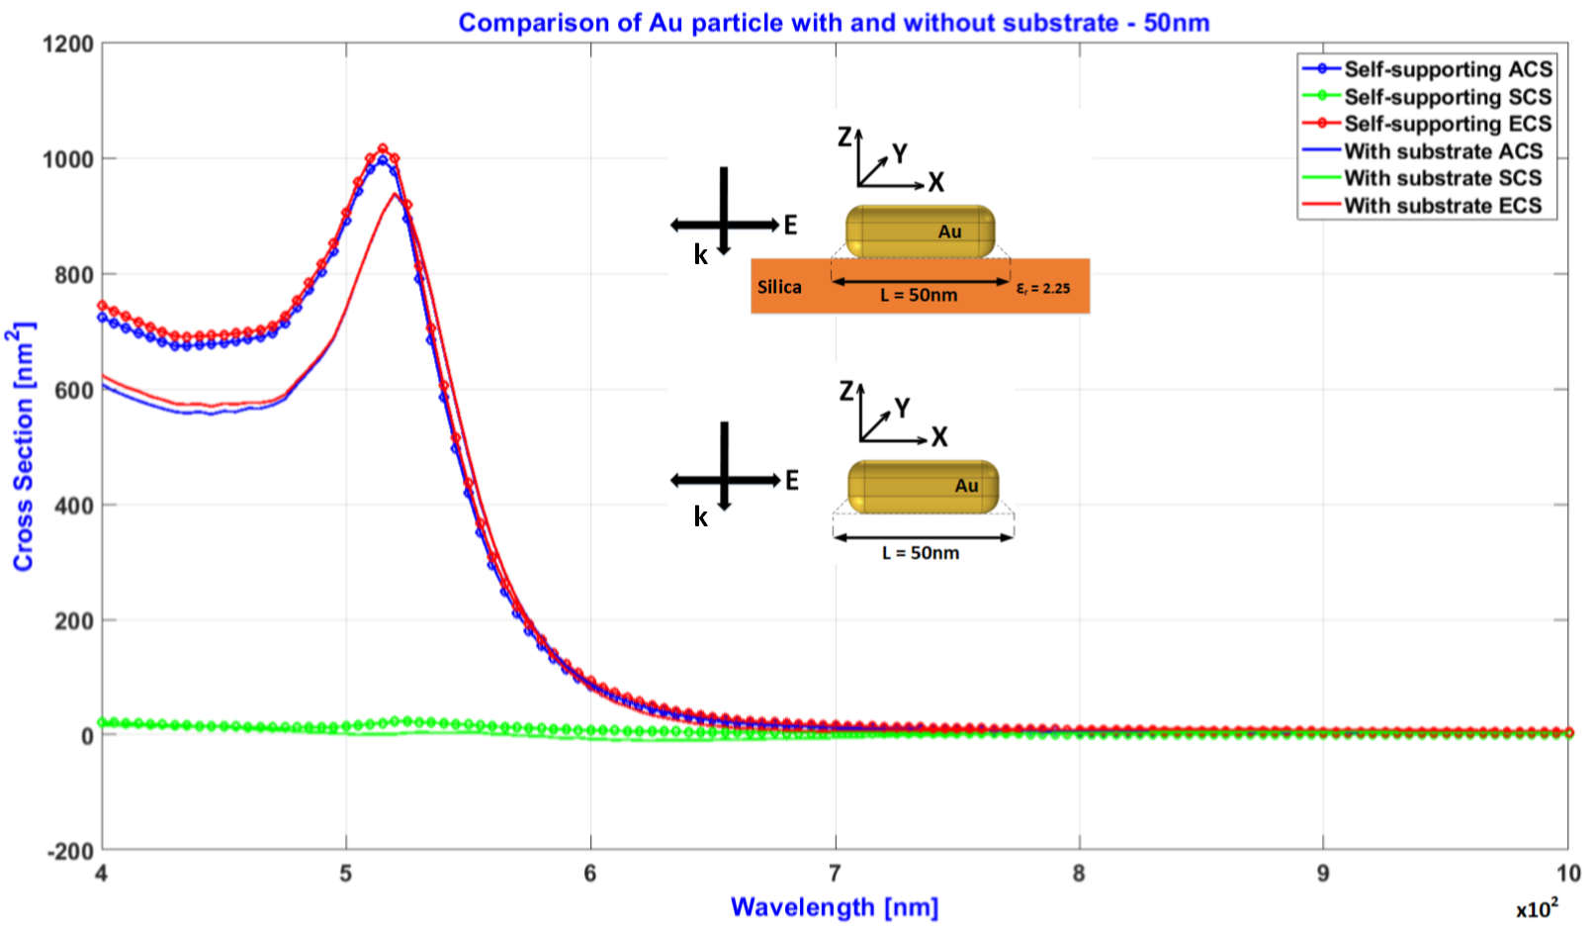
Au nanoprism on substrate, L = 50nm
515nm
520nm

Slide 24
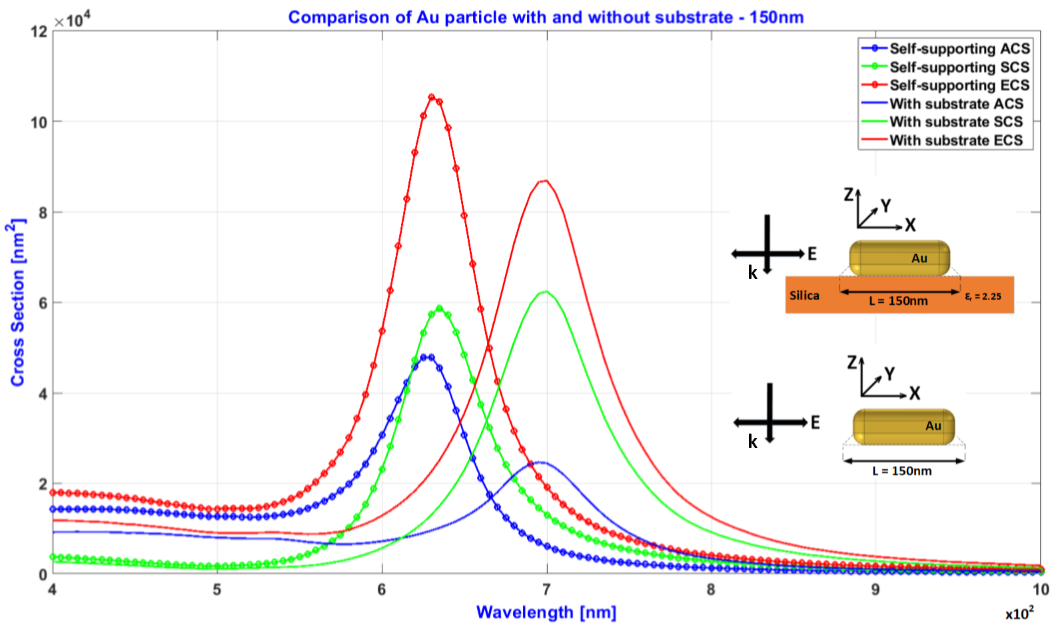
Au nanoprism on substrate, L = 150nm
630nm
695nm

Slide 25
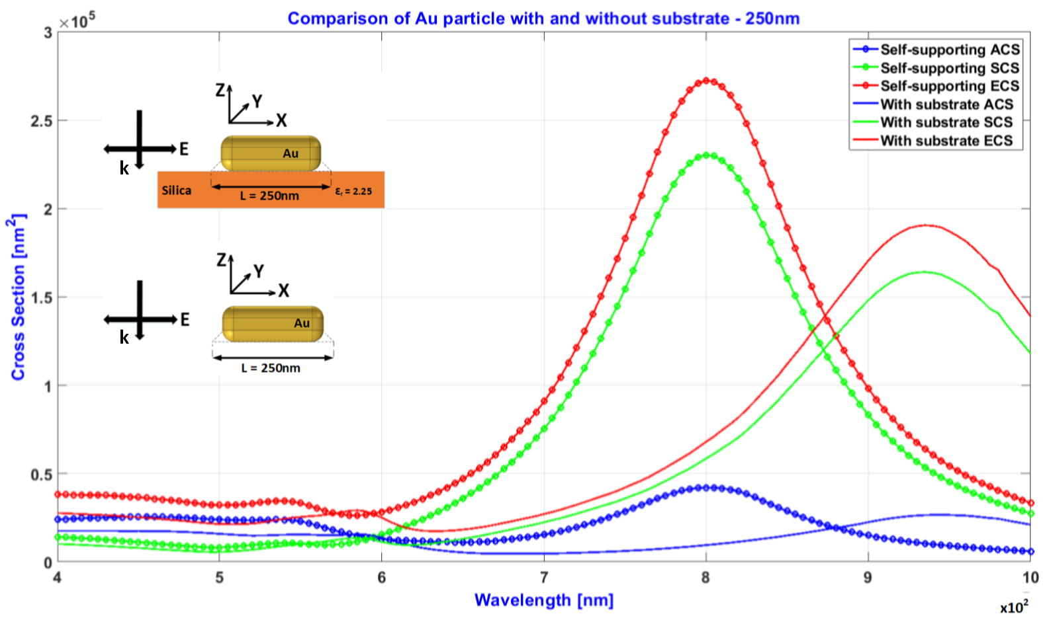
Au nanoprism on substrate, L = 250nm
800nm
935nm
545nm
585nm

Slide 26
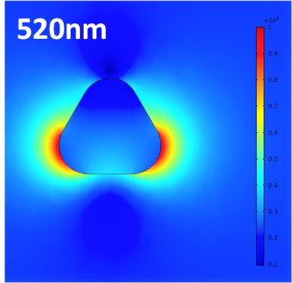
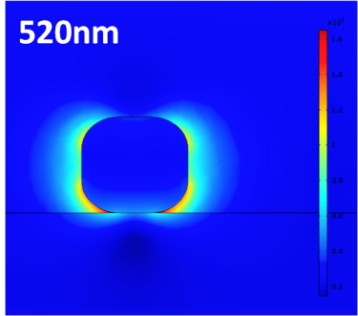
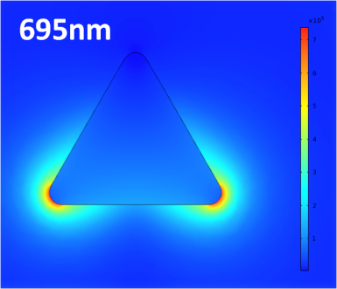





Near-field plots- nanoprism on substrate
L = 50nm
L = 150nm
xy-plane
xz-plane
xy-plane
xz-plane
L = 250nm
L = 250nm
xy-plane
xz-plane
xy-plane
xz-plane
Dipolar resonance
Quadrapolar resonance

Slide 27


Visualizing near-field
250nm
z
E
y
k
x
Wavelength(nm)
10²

Slide 28

Comparing resonant frequency shifts
Nanoprism length (L) | Self-supporting | Au on substrate
50nm | 515nm | 520nm
75nm | 535nm | 555nm
100nm | 565nm | 600nm
150nm | 630nm | 695nm
200nm | 710nm | 815nm, 550nm
250nm | 800nm, 545nm | 935nm, 585nm

Slide 29




ACS vs SCS

Slide 30
Summary
Positive shift in resonant frequency for increase in particle size
Absorption dominated for smaller particle sizes and scattering dominated for larger particle sizes
Different approaches of SCS calculation have same result
In the presence of substrate the particle experiences a positive resonance shift
Different plane waves caused degenerate frequencies in the presence of substrate

Slide 31
Future work
Modelling two triangle prism Au nanoparticle facing each other separated by a small distance and study their optical and electromagnetic properties
The semi-inﬁnite dielectric substrate in the model 2 can be replaced by diﬀerent shapes, sizes and materials
Varying the angle of propagation and polarization of the plane wave

Slide 32
References
Jeﬀrey S. Crompton Sergei Yushanov and Kyle C. Koppenhoefer. "Mie Scattering of Electromagnetic Waves". https://www.comsol.com/paper/download/181101/crompton_paper.pdf.
British Museum. "The Lycurgus Cup". https://britishmuseum.tumblr.com/post/120689869617/the-lycurgus-cup
"The Stained Glass of Sainte-Chapelle in Paris". https://www.reddit.com/r/travel/comments/8smwhx/the_stained_glass_of_saintechapelle_in_paris/
WilliamL.Barnes,AlainDereux,andThomasW.Ebbesen. "Surface Plasmon Subwavelength Optics". Nature, 424:824–830, 08 2003. https://www.nature.com/articles/nature01937

Slide 33
Thank You !

